Slide 1


Group 10
Gayatri R., Janet R., Somayyeh K., Chris S., Ekene O.

Slide 2

INTRODUCTION
Overview of Stroke Risk Prediction:
Stroke is a leading cause of disability and death, often occurring suddenly, with severe consequences for individuals and healthcare systems.
Importance of early prediction using ML:
Early stroke risk prediction using machine learning enables timely interventions, potentially preventing strokes and improving outcomes.
Goal of the Project:
The primary goal of this project is to develop a predictive model that estimates stroke risk based on health and lifestyle data. By identifying high-risk individuals early, this model aims to support healthcare providers in making informed decisions, enabling preventive measures and personalized health recommendations.

Slide 3
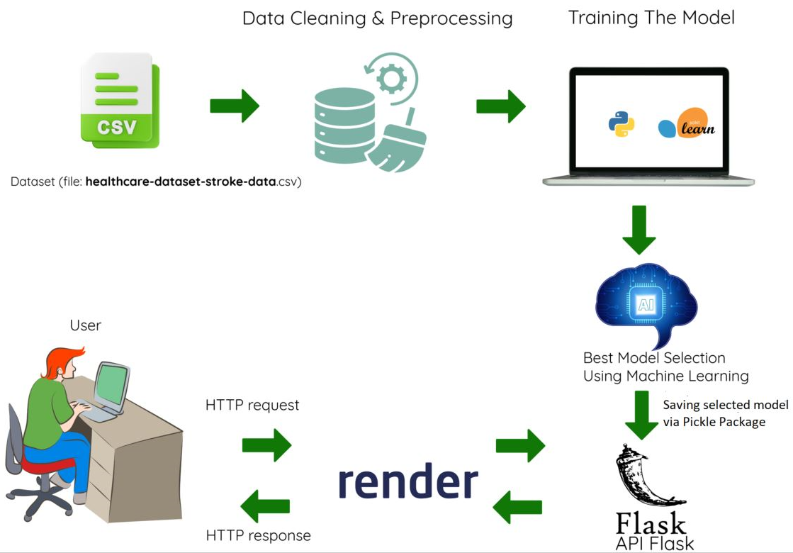
OVERVIEW OF THE PROJECT:

Slide 4
DATA CLEANING & PREPROCESSING
Dataset Source:
https://www.kaggle.com/datasets/fedesoriano/stroke-prediction-dataset/data
The dataset consists of 5,110 records with 12 features, focusing on demographic, health, and lifestyle factors that influence stroke risk.
Handling Missing Values:
The null values in the bmi column were removed. The smoking_status column included an "unknown" category, which was retained due to a high number of entries with this value
Encoding categorical variables:
Categorical data in columns such as ever_married, Residence_type, smoking_status, work_type, and gender were encoded using the get_dummies method.
Splitting data into train & test sets:
After applying SMOTE to handle class imbalance, the resampled dataset was split into training and testing sets using an 80-20 ratio. The train_test_split function was used with a fixed random state to ensure reproducibility.
Standardization:
Numerical features such as age, BMI, and glucose levels were standardized for consistent scaling across the model.

Slide 5
MODEL TRAINING & SELECTION:
Models tested:
Random Forest
SVM
Logistic Regression
Voting Classifier (Logistic Regression + Random Forest)
Voting Classifier (Logistic Regression + Random Forest + SVM)
XGBoost
XGBoost with Random Forest, Logistic Regression & SVM
Neural Network with MLP Classifier
Performance metrics used:
Accuracy, Confusion Matrix, Classification Report
Comparison of Results:
XGBoost outperformed the other models with an accuracy of 96.8%
Final Model Selection & Reasons
The model achieved 96.81% accuracy, correctly classifying most cases with a small number of misclassifications (24 false positives, 35 false negatives). It maintained a high precision (96%-97%) and recall (96%-97%) for both stroke and non-stroke cases, resulting in a strong F1-score of 0.97. Overall, the model demonstrates excellent performance with balanced precision and recall, making it effective for stroke prediction.

Slide 6
FLASK API DEVELOPMENT:
Overview of Flask:
Flask is a lightweight and flexible web framework for Python, ideal for building APIs and web applications.
It provides built-in support for routing, request handling, and template rendering, making it easy to develop and deploy machine learning models as web services.
Creating API Endpoints:
API endpoints are defined using Flask’s @app.route() decorator, allowing users to send requests and receive responses.
The /predict endpoint processes input data, applies transformations, and returns stroke prediction results based on the trained model.
Loading Trained Model in Flask:
The trained model and scaler are loaded using joblib.load(), ensuring they are available for making predictions.

Slide 7
DEPLOYMENT ON RENDER:
Why Render for deployment:
Easy deployment & scalability
Free tier & Managed Services
Steps to Deploy Flask API on Render:
Prepare Your Flask App for Deployment
Ensure all dependencies are listed in a requirements.txt file (pip freeze > requirements.txt).
Create a Procfile (if deploying as a web service) with: web: gunicorn app:app
Push Your Code to GitHub
Deploy on Render
Go to Render.com and sign up/log in.
Click on New Web Service and connect your GitHub repository.
Set the runtime as Python and specify the start command as: gunicorn app:app
Choose a free or paid tier based on project needs.
Click Deploy, and Render will automatically build and host your Flask API.
.
Deployed @
https://project4-machinelearning.onrender.com/

Slide 8
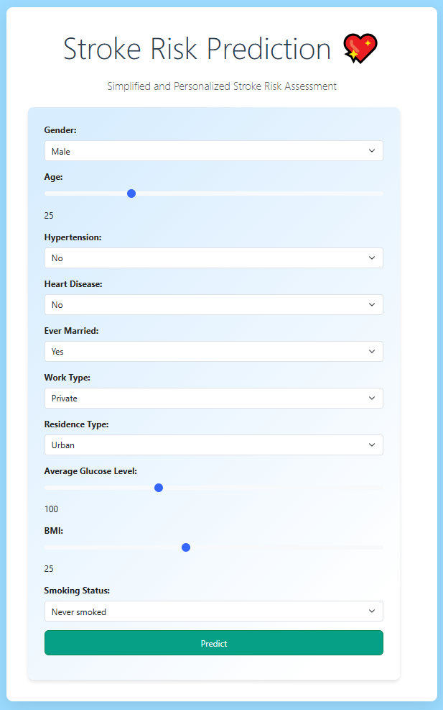
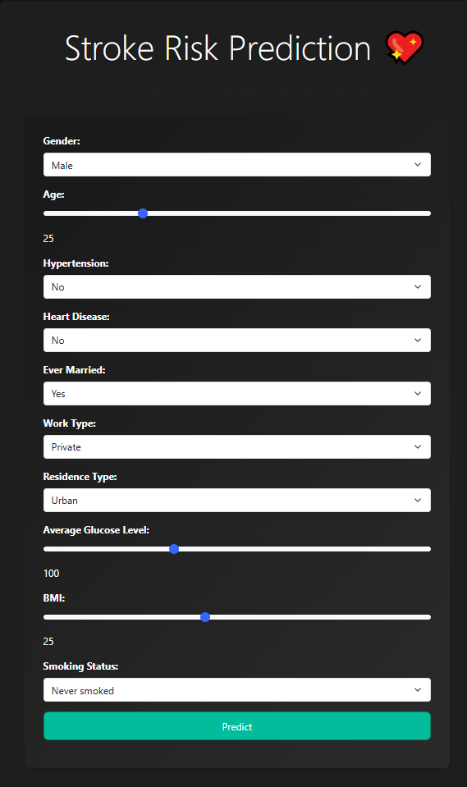
Light Mode
Dark Mode
Stroke Risk Prediction Tool- Frontend Interface
The app’s personalized recommendations can help users reduce their stroke risk by suggesting actionable lifestyle and medical interventions based on their risk prediction
The person is at a risk of stroke:
Consult a healthcare provider immediately.
Quit smoking if applicable.
Medication: Consider blood pressure or cholesterol management.
Lifestyle Changes: Reduce salt and alcohol intake, increase physical activity
The person is not at a risk of stroke):
Maintain current lifestyle: Continue regular exercise and a balanced diet.
Annual Check-ups: Recommended for ongoing monitoring.
Avoid Smoking: Continue avoiding smoking for long-term benefits.

Slide 9
CONCLUSION & KEY FINDINGS:
Model Performance:
The machine learning model developed for stroke prediction performed reasonably well based on accuracy and other metrics like precision, recall, and F1-score.
Potential Improvements:
The dataset used for training could benefit from additional samples to improve generalizability. Increasing the dataset size may help reduce overfitting and improve model accuracy.
Exploring Neural Networks: Further experimentation with neural networks, including fine-tuning hyperparameters, could potentially enhance model performance and provide deeper insights into stroke prediction.
Next Steps:
Continuous Monitoring: After deployment, it’s important to monitor the model's performance and retrain it periodically with updated data to maintain its accuracy over time.
Integration with Healthcare Systems: Explore opportunities for integrating the model into healthcare applications or systems to aid in early detection and prevention of strokes.
Collaboration with Experts: Collaborating with medical professionals to validate the predictions and model performance in real-world scenarios is crucial for improving reliability.
.

